Slide 1
CSE 430: Software Quality Assurance and Testing
Anika Tabassum
Lecturer
CSE, EWU

Slide 2
Lecture 04
Introduction to Software Testing

Slide 3
Software Testing Definitions
Many practitioners and researchers have defined software testing in their own way.

Slide 4
Testing is the process of demonstrating that there are no errors.

Slide 5
Testing is the process of executing a program with the intent of finding errors.
- Myers

Slide 6
Software testing is a process that detects important bugs with the objective of having better quality software.

Slide 7
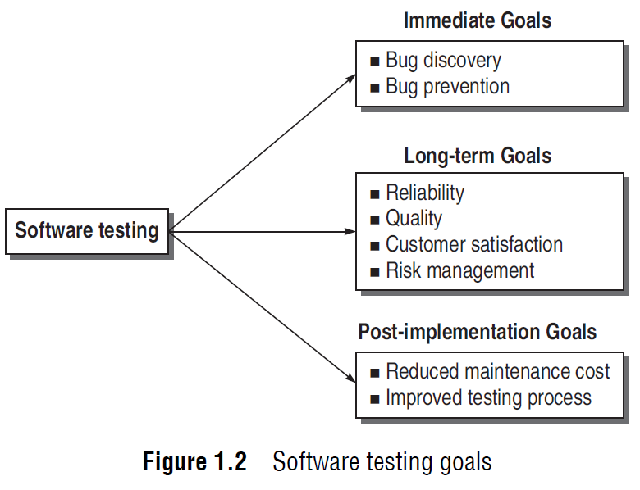
Goals of Software Testing

Slide 8
Short term or Immediate goals
Bug Discovery : more the bug discovered in the early stage, better be the success rate of software testing
Bug Prevention: From the behaviour and interpretation of bugs discovered, everyone in the software development team gets to learn how to code safely such that the bugs discovered should not be repeated in later stages or future projects. Though errors cannot be prevented to zero, they can be minimized.

Slide 9
Long-term goals
Quality: the first goal of understanding and performing the testing process is to enhance the quality of the software product.
Reliability: Reliability is a matter of confidence that the software will not fail, and this level of confidence increases with rigorous testing.

Slide 10
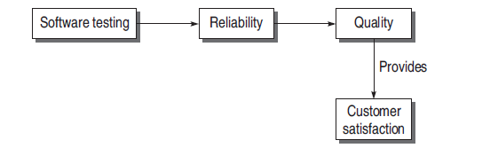
Long-term goals
Customer satisfaction : A complete testing process achieves reliability, reliability enhances the quality, and quality in turn, increases the customer satisfaction.
Risk management : Risks must be controlled to manage them with ease. Software testing may act as a control, which can help in eliminating or minimizing risks

Slide 11
Post-implementation goals
Reduced maintenance cost: If testing has been done rigorously and effectively then the chances of failure are minimized and in turn, the maintenance cost is reduced.
Improved software testing process : the bug history and post-implementation results can be analysed to find out snags in the present testing process which can be rectified in future projects.

Slide 12
Testing may indicate that the software being developed cannot be delivered on time, or there is a probability that high priority bugs will not be resolved by the specified time. With this advance information, decisions can be made to minimize risk situation.

Slide 13
Software Testing- Myths and Facts
Myth- Testing is a single phase is SDLC
Myth- Testing is easy
Myth- Software development is worth more than testing
Myth- complete testing is possible
Myth- Testing starts after program development
Myth- The purpose of testing is to check the functionality of the software
Myth- Anyone can be a tester

Slide 14
Effective Software Testing Vs. Exhaustive Software Testing
Exhaustive or complete software testing means that every statement in the program and every possible path combination with every possible combination of data must be executed.
Exhaustive testing is out of scope

Slide 15
Effective Software Testing Vs. Exhaustive Software Testing
When are we done with testing?
How do we know that we have tested enough?
There many be answers for these questions with respect to time, cost, customer, quality, etc.

Slide 16
Effective Software Testing Vs. Exhaustive Software Testing
This combination of possible tests is infinite
Processing resources and time are not sufficient for performing these tests
Computer speed and time constraints limit the possibility of performing all the tests
Complete testing requires the organization to invest a long time which is not cost-effective

Slide 17
Effective Software Testing Vs. Exhaustive Software Testing
Testing must be performed on selected subsets that can be performed within the constrained resources.
This selected group of subsets, but not the whole domain of testing, makes effective software testing.
Effective testing can be enhanced if subsets are selected based on the factors which are required in a particular environment.

Slide 18
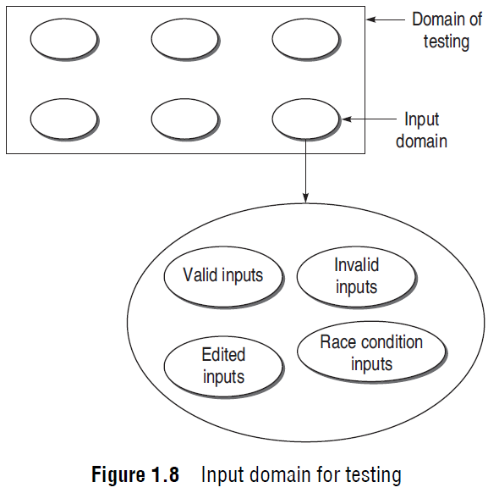
The Domain of Possible Inputs to the Software is too Large to Test

Slide 19
Example
Consider a very simple example of adding two-digit two numbers.
range is from –99 to 99 (total 199).
total number of test case combinations: 199 × 199 = 39601.
if the range is four-digits then it will be 399,960,001.
Most addition programs accept 8 or 10 digit numbers or more
How can we test all these combinations of valid inputs?

Slide 20
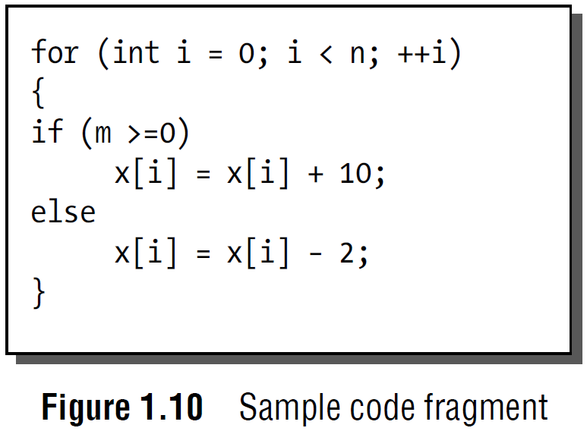
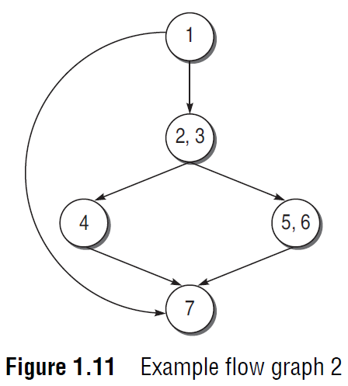
There are too Many Possible Paths Through the Program to Test

Slide 21
Example
there are two paths in one iteration.
the total number of paths will be 2^{n} + 1
if n is 20, then the number of paths will be 2²⁰ + 1 = 1048577
All these paths cannot be tested, as it may take years.

